Slide 1

Getting Started with Stock Synthesis (SS3)

Slide 2
How to use these slides
This powerpoint is aimed at users who are new to SS3 and to running executables via the command line.
This will cover several workflows for running existing SS3 models.
Please see the SS3 user manual for more details

Slide 3
Main SS3 files
Output for debugging:
warning.sso
echoinput.sso
ParmTrace.sso
4 Input files:
starter.ss
MyControlFile.ss¹
MyDataFile.ss¹
forecast.ss
optional: wtatage.ss
Output with results:
ss_summary.sso
Report.sso
CompReport.sso
covar.sso
Forecast-report.sso
ss3.par
Executable
ss3.exe²
Output that mirrors input:
Shows all input options
and simulated data
starter.ss_new
control.ss_new
data_echo.ss_new
forecast.ss_new
wtatage.ss_new
¹Can have any name, as long as specified in the starter file.
²The SS3 executable can have any name.

Slide 4
Associated tools
Output for debugging
warning.sso
echoinput.sso
ParmTrace.sso
Stock Assessment Continuum Tool
Output with results
ss_summary.sso
Report.sso
CompReport.sso
covar.sso
Forecast-report.sso
ss3.par
Any text editor
Input files
starter.ss
MyControlFile.ss
MyDataFile.ss
forecast.ss
optional: wtatage.ss
Stock Assessment Continuum Tool
Executable
ss3.exe
r4ss
Output that mirrors input
Shows all input options
and simulated data
starter.ss_new
control.ss_new
data_echo.ss_new
forecast.ss_new
wtatage.ss_new
Any text editor
r4ss
Please see slide notes for definitions of some of these tools
Notes:
Some definitions:
r4ss: an R package. Available at: https://github.com/r4ss/r4ss
The Helper Shiny App is also available through the following link: https://connect.fisheries.noaa.gov/ss3-helper/. Note that the shiny app is designed as a reference to help the user set up their model..

Slide 5
The four input files read by ss.exe
starter.ss: Required file containing file names of the data file and the control file plus other run controls. Must be named starter.ss.
Data file: File containing model dimensions and the data. Can have any name, but typically ends in .ss or .dat. Must match the name in the starter file.
Control file: File containing set-up for the parameters. Can have any name, but typically ends in .ss or .ctl. Must match the name in the starter file.
forecast.ss: File containing specifications for reference points and forecasts. Must be named forecast.ss.

Slide 6
Two optional input files
ss3.par: Text file with one line per parameter where order matters. Could be created from a previous model run. Read in ss.par to overwrite the initial parameter values in the control file (chose whether or not to read ss3.par in starter.ss).
wtatage.ss: File containing empirical input of body weight by fleet and population and empirical fecundity-at-age (choose whether or not to read in a line of the control file)

Slide 7
Running SS3
SS3 typically runs in a command window
One folder approach
Two folder approach
PATH approach
It is also possible to download the SS3 exe and run SS3 via the command line from within R using {r4ss}

Slide 8
Interface Comparison
Command window
Input test files, with replicas produced by SS3, contain verbose info regarding model options
Hands on, messy text file editing
R with {r4ss}
Most advanced processing and display of model output
Scripts to read and write model input files, but no hand-holding or verbose descriptions
Ability to download the SS3 executable
Vignettes to run SS3 and a family of SS3 dependent models

Slide 9
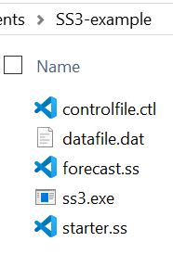
Running SS3: The one folder approach. Model files and exe in same folder
Create a folder and add:
ss3.exe
starter.ss
Control File (Must match name in starter.ss)
Data File (Must match name in starter.ss)
forecast.ss
Optional files: wtatage.ss (if doing empirical wt-at-age approach) or ss3.par (to continue from a previous run)

Slide 10
Pros and cons of the one folder approach
Pro: Simple setup to run models
Con: If you update your version of SS3, then you may need to update it in many folders
Con: Requires 1 copy of the executable per folder, which will take up a large amount of space when running many models

Slide 11
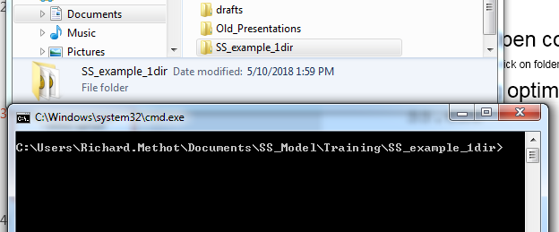
Starting SS3 from the command line
Click here to highlight.
Then shift right-click to get to “open command window here” option.
Which opens cmd.exe in that directory.
Then type ss3 (or other name of the ss3 exe) and hit <enter>
See notes for more tips on running an SS3 model from the command line.
Notes:
Download the simple example to try this out!
From within the folder with the SS model, also control+shift+right click to open the command line. No need to back out of the folder as shown on the slide.
On Windows, there are several command line options. Two of the most common ones are the command prompt or PowerShell (Windows modern successor to the command prompt), which work differently, but it is possible to run SS from either of them.
Finally, you may be able to simply click on the ss.exe to run it with the model files when they are in the same folder
Some tips if you have issues: If typing ss doesn’t work, check that the file path is correct. In this example, the executable ss.exe would need to be directly in the folder SS_example_1dir , and not inside of a subfolder within it. If the executable is named something else, then you would type that into the command line. (for example, an executable named ss_opt.exe would require typing ss_opt into the command line. You can also try typing the executable name with extension .exe if running on Windows.

Slide 12
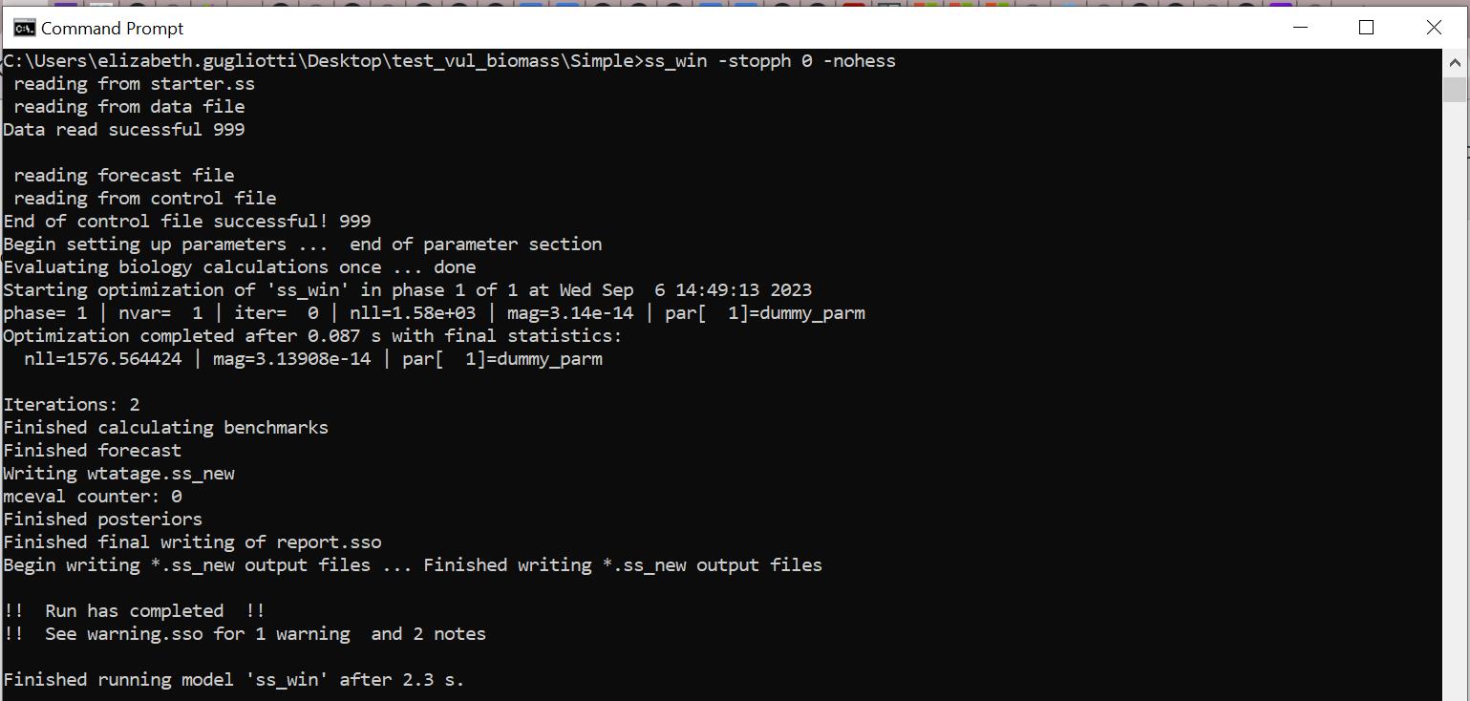
Command line messages after starting an SS3 run
Volume of information controlled in starter.ss file: 1 # run display detail (0,1,2) Middle level (1) is usually best.

Slide 13
SS3 always opens and reads files in the same order, writing to echoinput.sso as it reads
SS3 inputs are read in order by value, without reference to comments. Depending on the SS3 options selected, SS3 will expect a certain number of values in a certain order, so failing to provide them will result in errors or at least a different model specification than intended.
Reading order of files: SS3 opens and reads starter.ss, then the data file, then forecast.ss, then the control file, then wtatage if using (optional), and finally ss3.par if using (optional).

Slide 14
SS3 run order of operations
SS3 proceeds immediately to pre-processing of the data, creation of internal parameter labels, etc. (order as described on the previous slide)
Some checks are written to echoinput.sso.
Problems written to warnings.sso.
Then, SS3 goes to the procedure section where ADMB makes iterative parameter changes to minimize the negative log likelihood
When ADMB achieves convergence, control passes to the sd_phase for calculation of parameter variance (unless –nohess option). After the sd_phase, it then goes to the benchmark and forecast code section, and then to the final reporting.
Results are written to the same directory

Slide 15
Screen output at the end of a run
If a run finishes, you will see something like:
!! Run has completed !! No warnings
(although it can complete with warnings also.)
If a run does not finish, you will not see this line and likely will see some other error message output.
Notes:
With this approach, you can have one (or more) folders with various versions of SS and many model user folders each with one (or more) batch files that point to various versions of SS.

Slide 16
Examining the output
Examine warnings.sso for issues and suggestions.
Many output files are created: Report.sso, Forecast-report.sso, etc.
Read the output and results into R using the {r4ss} function SS_output()
The results will include the following:
Calculated selectivity, biomass, F time series, numbers-at-age, fit to data, etc.

Slide 17
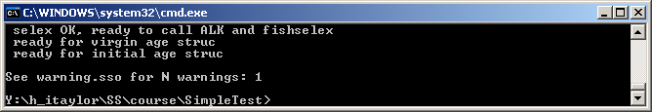
Warning.sso File
Always look at after running a model, regardless of whether the model run completed or not
Contains a list of warnings generated during program execution.
Note in command line if N warnings > 0
N warnings include:
Notification of errors in input files.
Some advice on parameter settings.

Slide 18
Other SS3 run workflows and optional ways to run

Slide 19
Run SS3: Using an SS3.exe in your PATH
The PATH is where your computer will search for files be default. Therefore, if an SS3 executable called ss3.exe is in your path, when you type ss3 into the command window, your computer will be able to find ss3.exe and use it with the model files in the current directory.
For more information, see the “Putting Stock Synthesis in your PATH” doc in the user manual.
After initial setup (once per computer), this makes using the same SS3 executable from many folders easy – you can run SS3 as if using the one folder approach, but there is no need to have the exe in the folder.

Slide 20
Running SS3 from within R
Running SS3 from within R may be desirable for setting up simulations where many runs of SS3 models are required or if {r4ss} is being used to read SS3 model output
You can use the function run("ss3")from the R console to run when executable ss3.exe in the same folder as model input files.
Another way is to use system("ss3")from the R console.
A variation on the two folder approach is in next slide

Slide 21
Running SS3 from within R
For direct specification of model location, use:
run_dir <- "C:/users/Richard.Methot/Documents/SS3_Model/
Training/2021_AFS/simple_long"
setwd(run_dir)
SS3_exe_path <- "C:/Users/Richard.Methot/Documents/GitHub/StockSynthesis_git/stock-synthesis/Compile/ss3.exe" #if you downloaded ss3 exe yourself
r4ss::run(dirvec = run_dir, model = SS3_exe_path, extras="-nohess -nox -maxI 10", intern=TRUE, verbose=FALSE, skipfinished = FALSE)
tmp <- SS_output(run_dir, covar=F)
SS_plots(tmp, uncertainty=F)
You can also use get_ss3_exe() to get the the ss3 exe.
SS3_exe_path<-get_ss3_exe() #downloads exe to working directory

Slide 22
Using ss3.par (previously ss.par) for initial values
Typically, SS3 uses initial parameter values in the control file. However, initial values can be read from the ss3.par file instead.
To use ss3.par instead, in starter.ss below the names of the data and control files, set the value to 1 rather than 0 on the line with comment
# 0=use init values in control file; 1=use ss3.par
Run model using one of the previously described workflows
Using the ss3.par file comes in handy when you want to use different initial values without modifying the control file. A ss3.par file is created during each model run, so using an ss3.par file from a previous model run will speed up run time if the initial values are closer to the MLE parameter estimates

Slide 23
Creating and modifying files
Start from an existing data, control, forecast, and starter *.ss_new files (which will be heavily annotated by SS3) as a template
Replace the file content with your data/parameter setup and update the descriptors in the text file.
Save each *.ss_new file as a *.ss and insert the new filenames for control and data files in the starter.ss file.
Do the same for the parameter file starting from an SS3 annotated control.ss_new, forecast, and starter *.ss_new files.
Notes:
“C

Slide 24
Command line options
ADMB options can be added to command line (ADMB).
Run without estimating anything: ss3 –noest OR ss3 –stopph 0
Skip standard errors (for quicker results, or to get Report.sso if Hessian does not invert): ss3 –nohess
Run MCMC
SS -mcmc 100000 -mcsave 100 (Runs 100,000 draws and saves every 100th.)
SS -mceval (Evaluates saved draws.)
List all command line options: ss3 -? OR ss3 -help
More info in ADMB Manual (Chapter 12: Command line options) http://www.admb-project.org/docs/manuals/

Slide 25
Some ADMB Tips
If you receive a memory allocation error.
Try ss3 –ams XXXXXX (i.e., 200000).
Or free up memory on your computer.
If it runs slow:
Probably writing to cmpdiff.tmp & gradfil1.tmp
Use –cbs XXXXXXX until cmpdiff.tmp=0 Mb
Use –gbs XXXXXXX until gradfil.tmp=0 Mb
When the model is running:
Press ‘n’: immediately goes to next phase.
Press ‘q’: immediately quits estimation.

Slide 26
Going further: Plotting results and basic troubleshooting

Slide 27
Using {r4ss} to organize and plot SS3 output
Two main functions: SS_output() and SS_plots()
# can also use pak to install
install.packages("remotes")
remotes::install_github("r4ss/r4ss")
library(r4ss) # use r4ss package on github
# create list of quantities for the model in mydir
replist <- SS_output(mydir)
SS_plots(replist)# create plots for SS run
See https://r4ss.github.io/r4ss/ for more details.

Slide 28
What to do when SS3 doesn't run?
Make sure all file names and directories / folders are named correctly (check that the starter file reference the correct names of control and data files). If file names and directories are named incorrectly, SS3 will not be able to find the file.
If it starts to read files and then crashes:
Look at warnings.sso.
Look at echoinput.sso and work backwards from the bottom, looking for where it doesn't match your inputs.
For further information please refer to SS3 User Manual “Running Stock Synthesis” subsections, especially “Re-Starting a Run” and “Debugging Tips.”

Slide 29
If the input is OK and then crashes…
If model crashes soon after starting the run, or if NAN messages appears on the screen, then:
Restart SS3 with the –stopph 0 option. This will read files, produce report output, and produce *.ss_new files.
Read Report.sso and Compreport.sso into {r4ss} to examine the details.
May show which likelihood component and which data have the NAN calculation.

Slide 30
If SS runs, but there is a large gradient at end.
Re-start from final values in the previous run by changing the Starter.ss file to:
1 # 0=use init values in control file
1=use ss.par
Examine Report.sso for parameters that are on or near bounds.
Examine residuals for gross lack-of-fit. If the residual are bad, ADMB may not be able to figure out which way to go.

Slide 31
Bad Hessian
Output file Report.sso includes information on parameter uncertainty.
In some cases, Hessian Matrix does not invert, and full the Report file is not produced.
Run model again using the following:
ss3 –nohess
Optional start from the final values in the previous run by changing Starter File to: 1 # 0=use init values in control file; 1=use ss3.par

Slide 32
How to get additional help?
SS3 GitHub (preferred)
Source code repository
Documentation/user manual
https://groups.google.com/g/ss3-forum
Github: post issues (bugs and feature requests) in the stock-synthesis and doc repositories or Discussions (on github)
SS3 Forum Google Group (preferred)
Fisheries Research special issue on Stock Synthesis
Emailing questions to nmfs.stock.synthesis@noaa.gov
Other users and models
http://www.capamresearch.org/

